Slide 1

HOW DID THAT GET THERE?
Jean-Pierre Voogt
@CloudySQL

Slide 2

What is a data breach?
A data breach occurs when sensitive, protected, or confidential data has been viewed, stolen or used by an unauthorized individual.
Data breaches may involve personal information or even trade secrets/intellectual property.

Slide 3


Slide 4

Social Engineering
Trust
Audit Companies to Test

Slide 5
Prevention
Default Password
SQL Injection
Training
Policies

Slide 6
Least Access Model
Do you really really need access to everything?

Slide 7
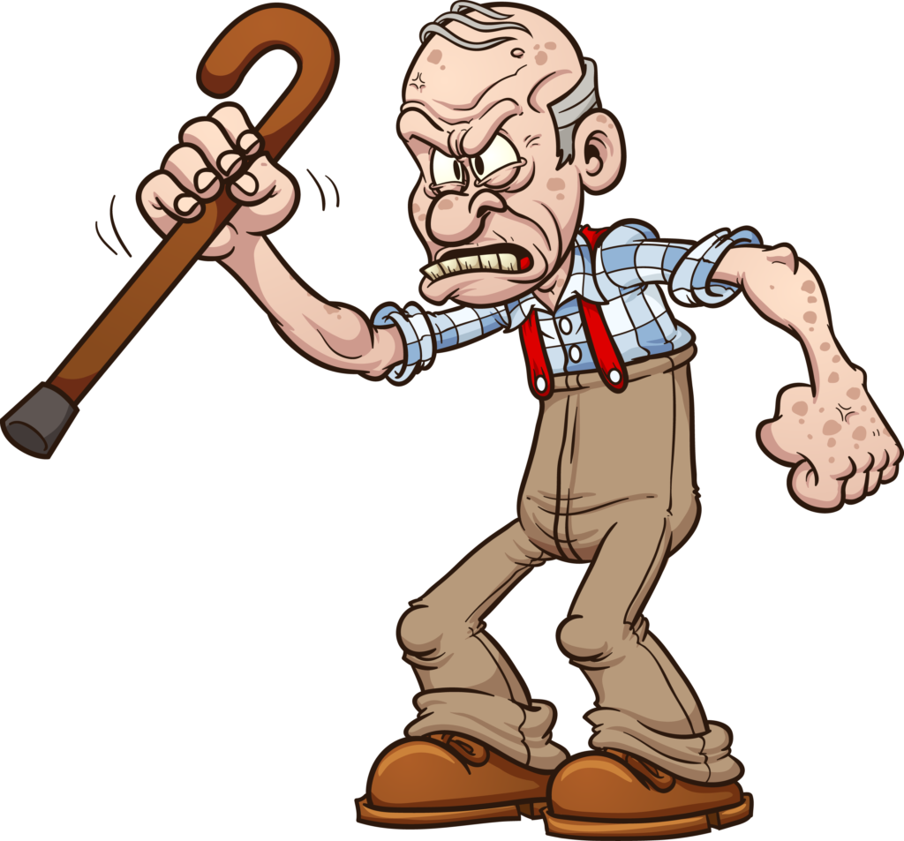
Obscure Data
Hide Personal Identifiable data
Store ID Numbers/Name/Surname in another Secured DB

Slide 8
Audit Logs & Transparency
Extended Events
MS Auditing
Network Auditing
Performance Baselines
Track Access to Sensitive Tables

Slide 9

Security
SSL Encryption over connections
Password Policies
Disable SA account

Slide 10
Extras
Keep on improving on Policies
Understand Your risk
Know where your data is
BYOD
Have an Emergency plan
Use an Ad blocker

Slide 11
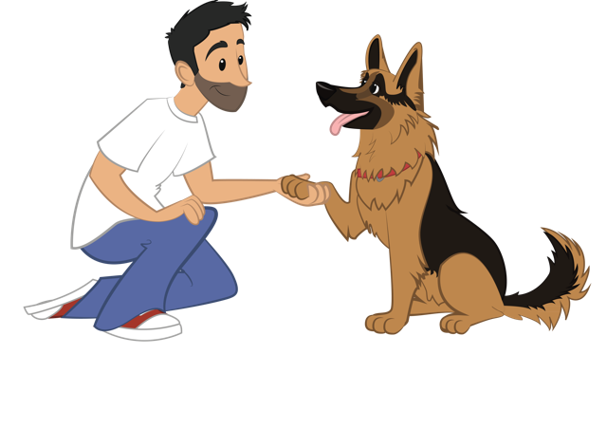
Training
Online training
Popcorn training
Plural sight
Hire a professional
Know how it happened to others

